Slide 1

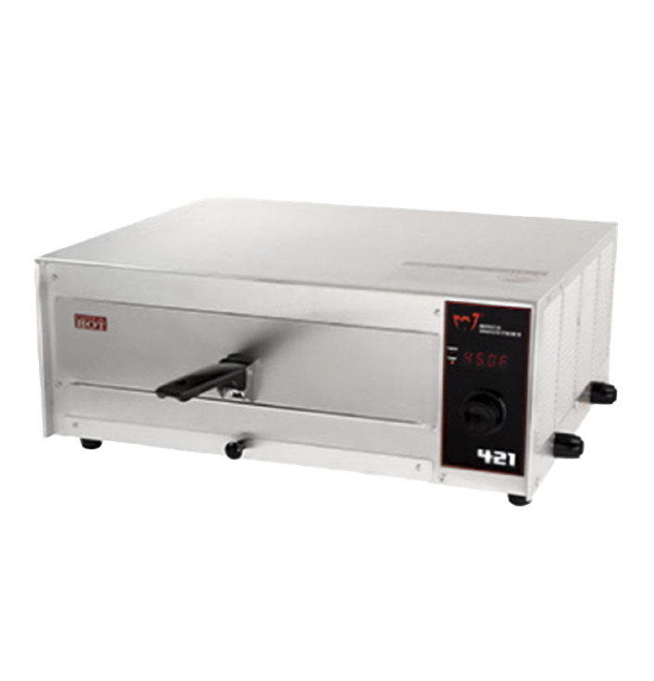
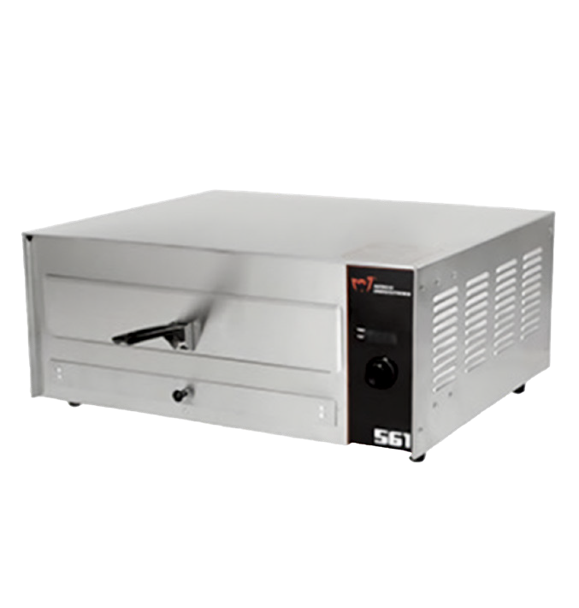
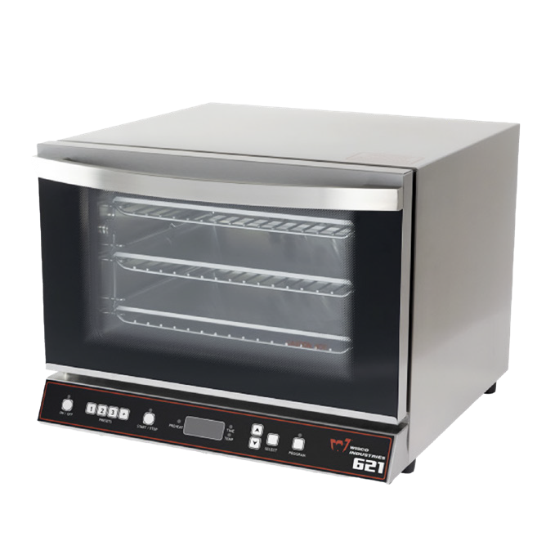
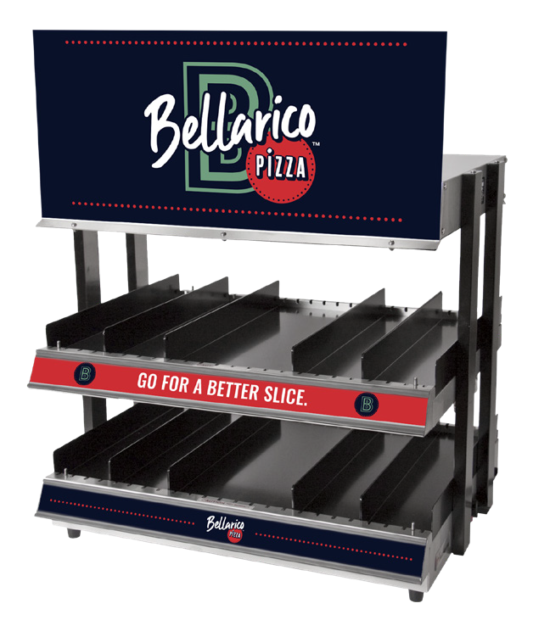
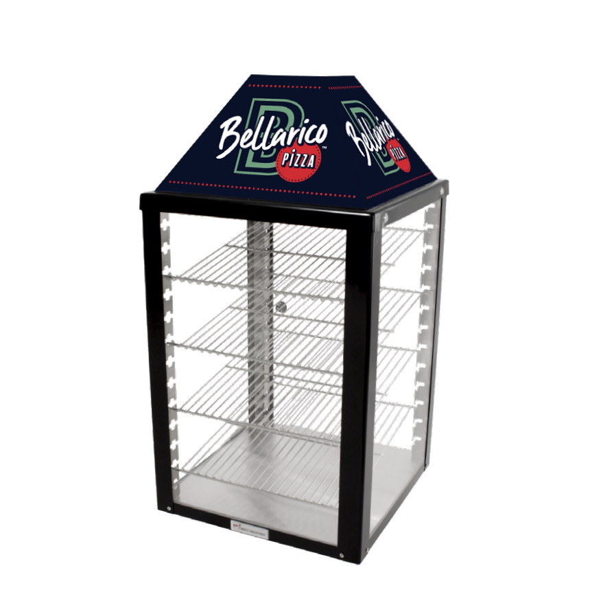
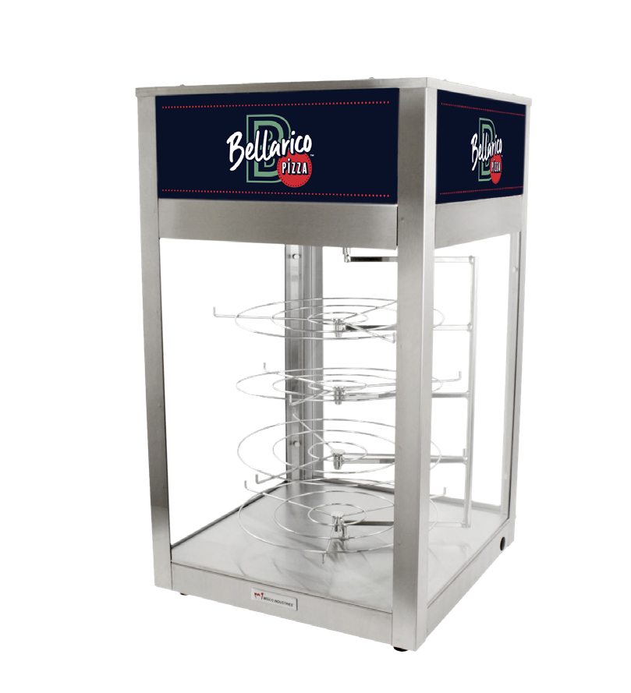
OVENS AND DISPLAY CASES
Wisco Deluxe Pizza Multi-Purpose Oven
Wisco Deluxe Pizza Multi-Purpose Oven
Wisco Deluxe Pizza Multi-Purpose Oven
421
561A
621
Model # 421
Item # 00421-001
Dimensions: 18” W x 15” D x 7 3/4”H 120v/12.5 amps/1500 watts
Model # 561A
Item # 00561A-001
Dimensions: 23 5/8” W x 19 1/2” D x 10 1/4”H 120v/14.2 amps/1700 watts
Model # 621
Item # 00621-001
Dimensions: 19” W x 18” D x 14 1/4”H 120v/10.9 amps/1300 watts
12” commercial, digital LED display, rotary dial design.
16” commercial, deluxe oven featuring a rotary dial design, 30 min digital display and one touch setting with time/temp memory.
Dedicated electrical circuit recommended.
Dedicated electrical circuit recommended.
This oven features a 3 step bake process with 10 programmable presets to make your baking process simpler. Heated, circulating
air throughout the oven penetrates food quickly.
Dedicated electrical circuit recommended.
QTY:
QTY:
QTY:
Wisco Warming/ Merchandising Cabinet
Wisco Warming/ Merchandising Cabinet
Wisco Warming/ Merchandising Cabinet
282
690
695D
-24
-25
Model # 690-25 Item #:
00690-25-128-BLK
Dimensions: 18” W x 18” D x
34” H
120v/5.3 amps/ 640 watts
Model # 695D Item # 00695D-128
Dimensions: 18 1/2” W x
8 1/2” D x 32” H
120v/8.5amps/ 1020 watts
Model # 282-24
Item # 00282-24-SR-128
Dimensions: 21” W x 25” D x 20 1/2”H 120v/12.5 amps/1500 watts
Adjustable thermostat, product illumination on both shelves for merchandising hot fast foods.
Dedicated electrical circuit recommended.
Adjustable thermostat with acrylic display; circulating heated
air to maintain food above
150°f for extended periods of time.
Dedicated electrical circuit recommended. 00690-25-128-BLK 1-door QTY
00690-25-2-128-BLK 2-door pass thru QTY
Adjustable thermostat to maintain food from 80°to above
150°. Has indicator lights for
water tank and glass panels & display ﬂoor that are easily removed for cleaning.
Dedicated electrical circuit recommended.
QTY:
QTY:
Store Name: Date: Contact Name: Phone: Email: Shipping Address (No P.O. Box): City: State: ZIP: Fax (608-835-7399) or email completed form to orderform@wiscoind.com
OFRM_6.27.23 L3

