Slide 1


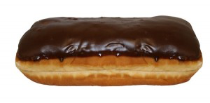
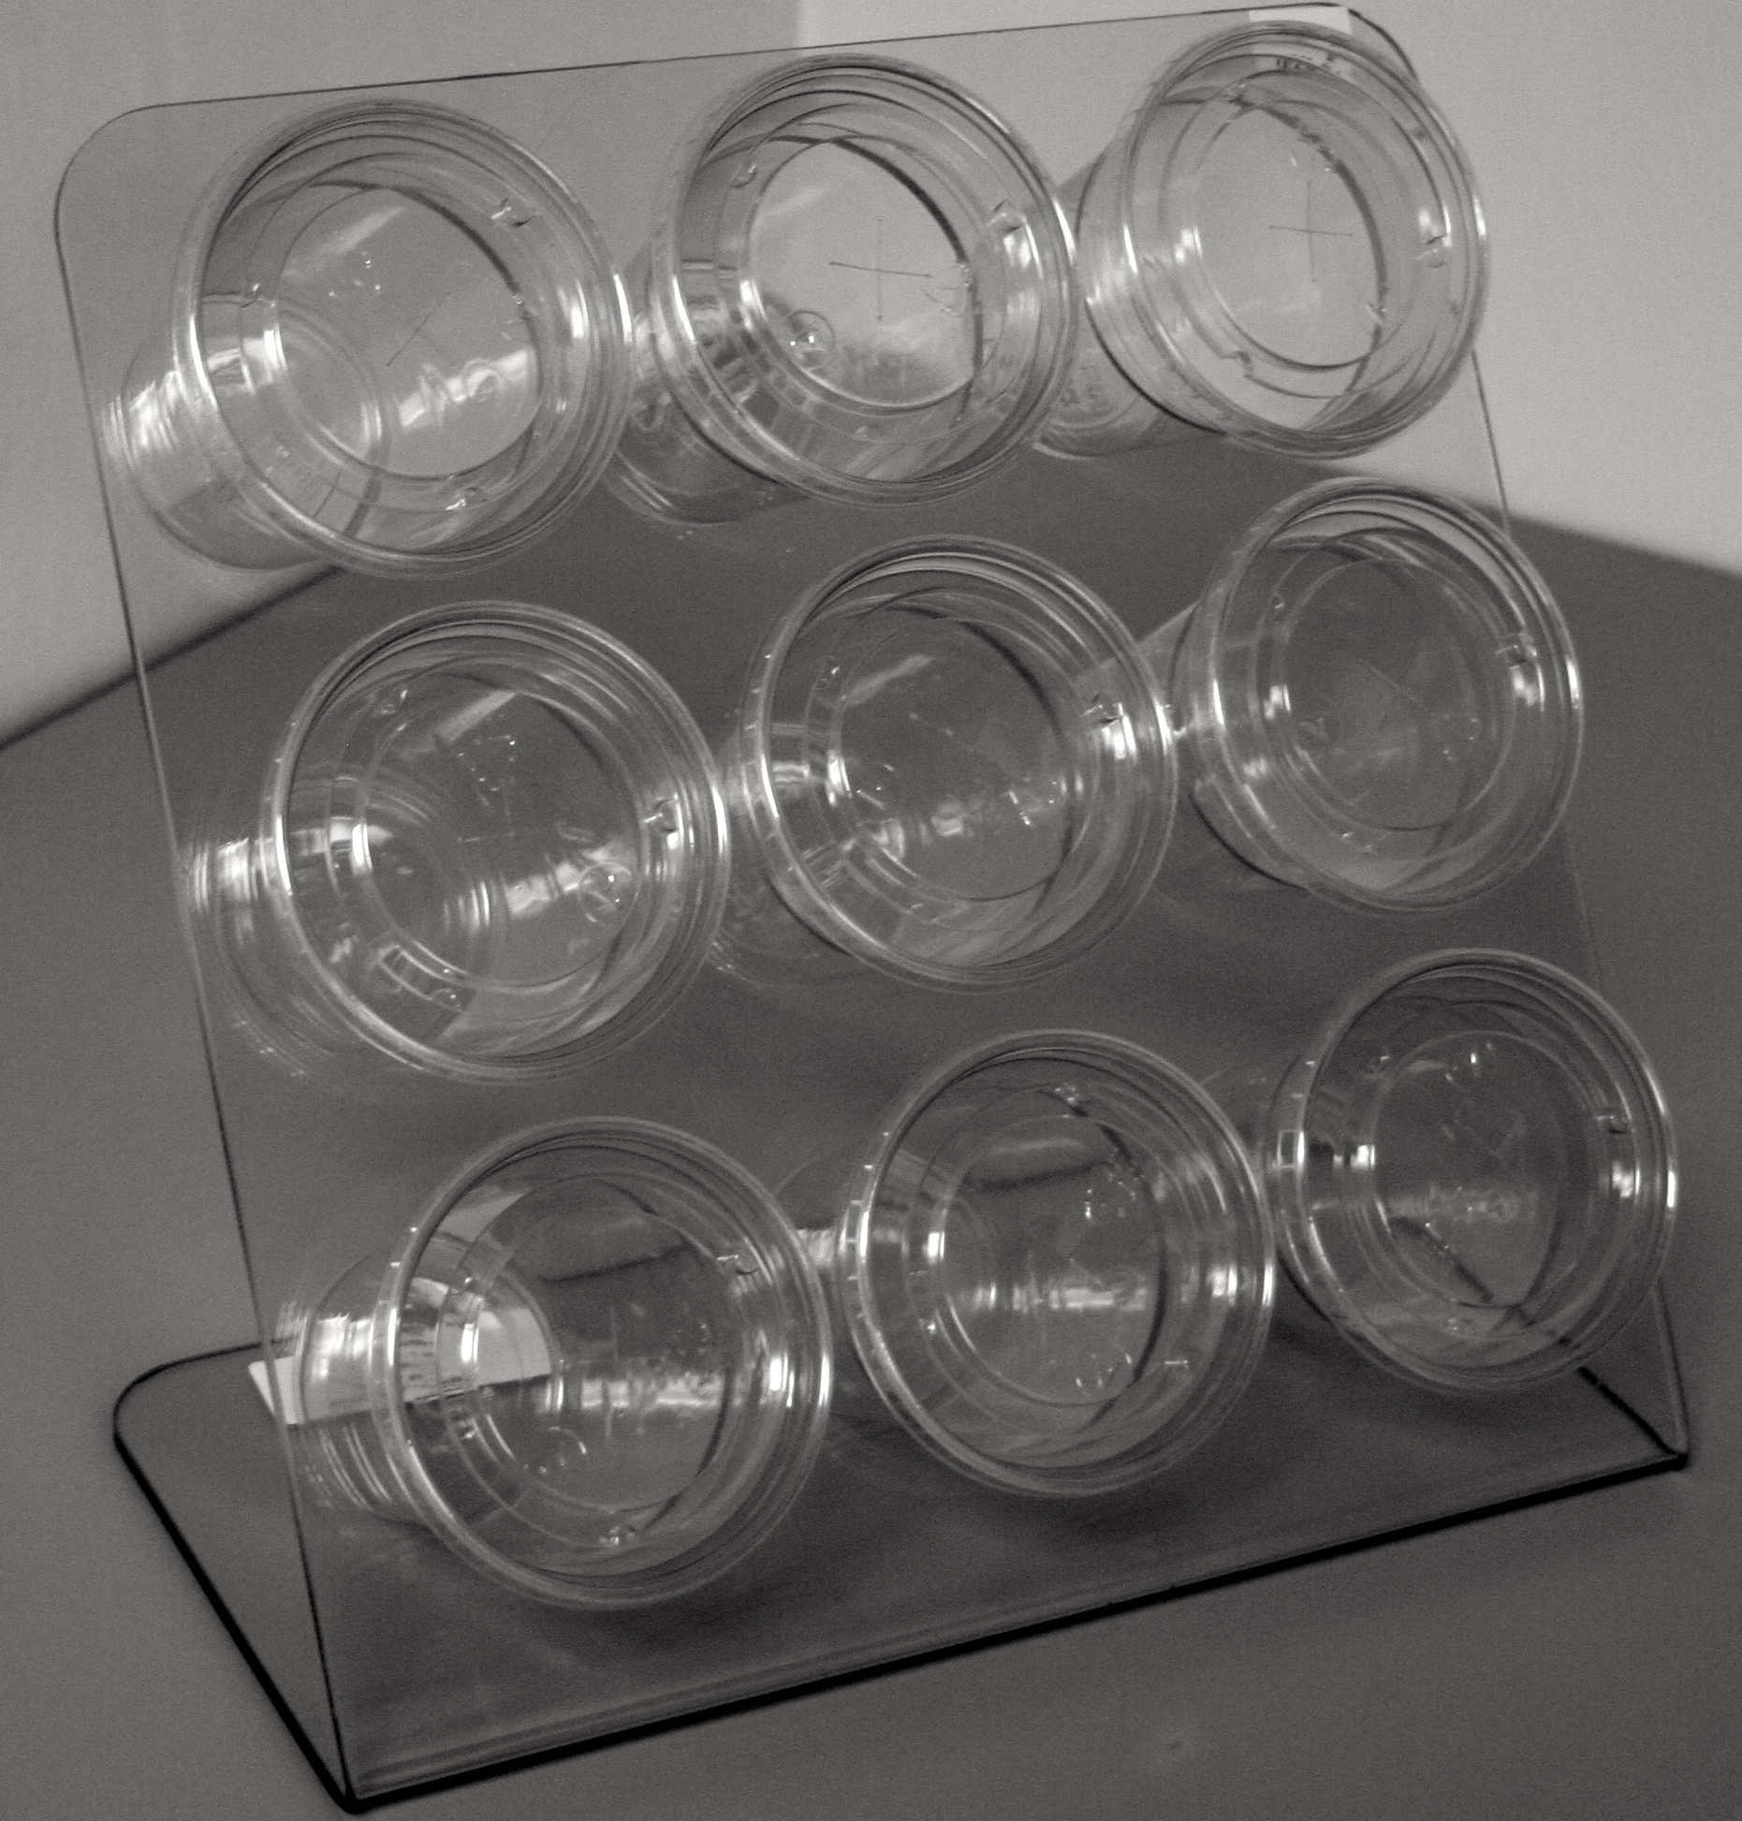
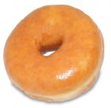
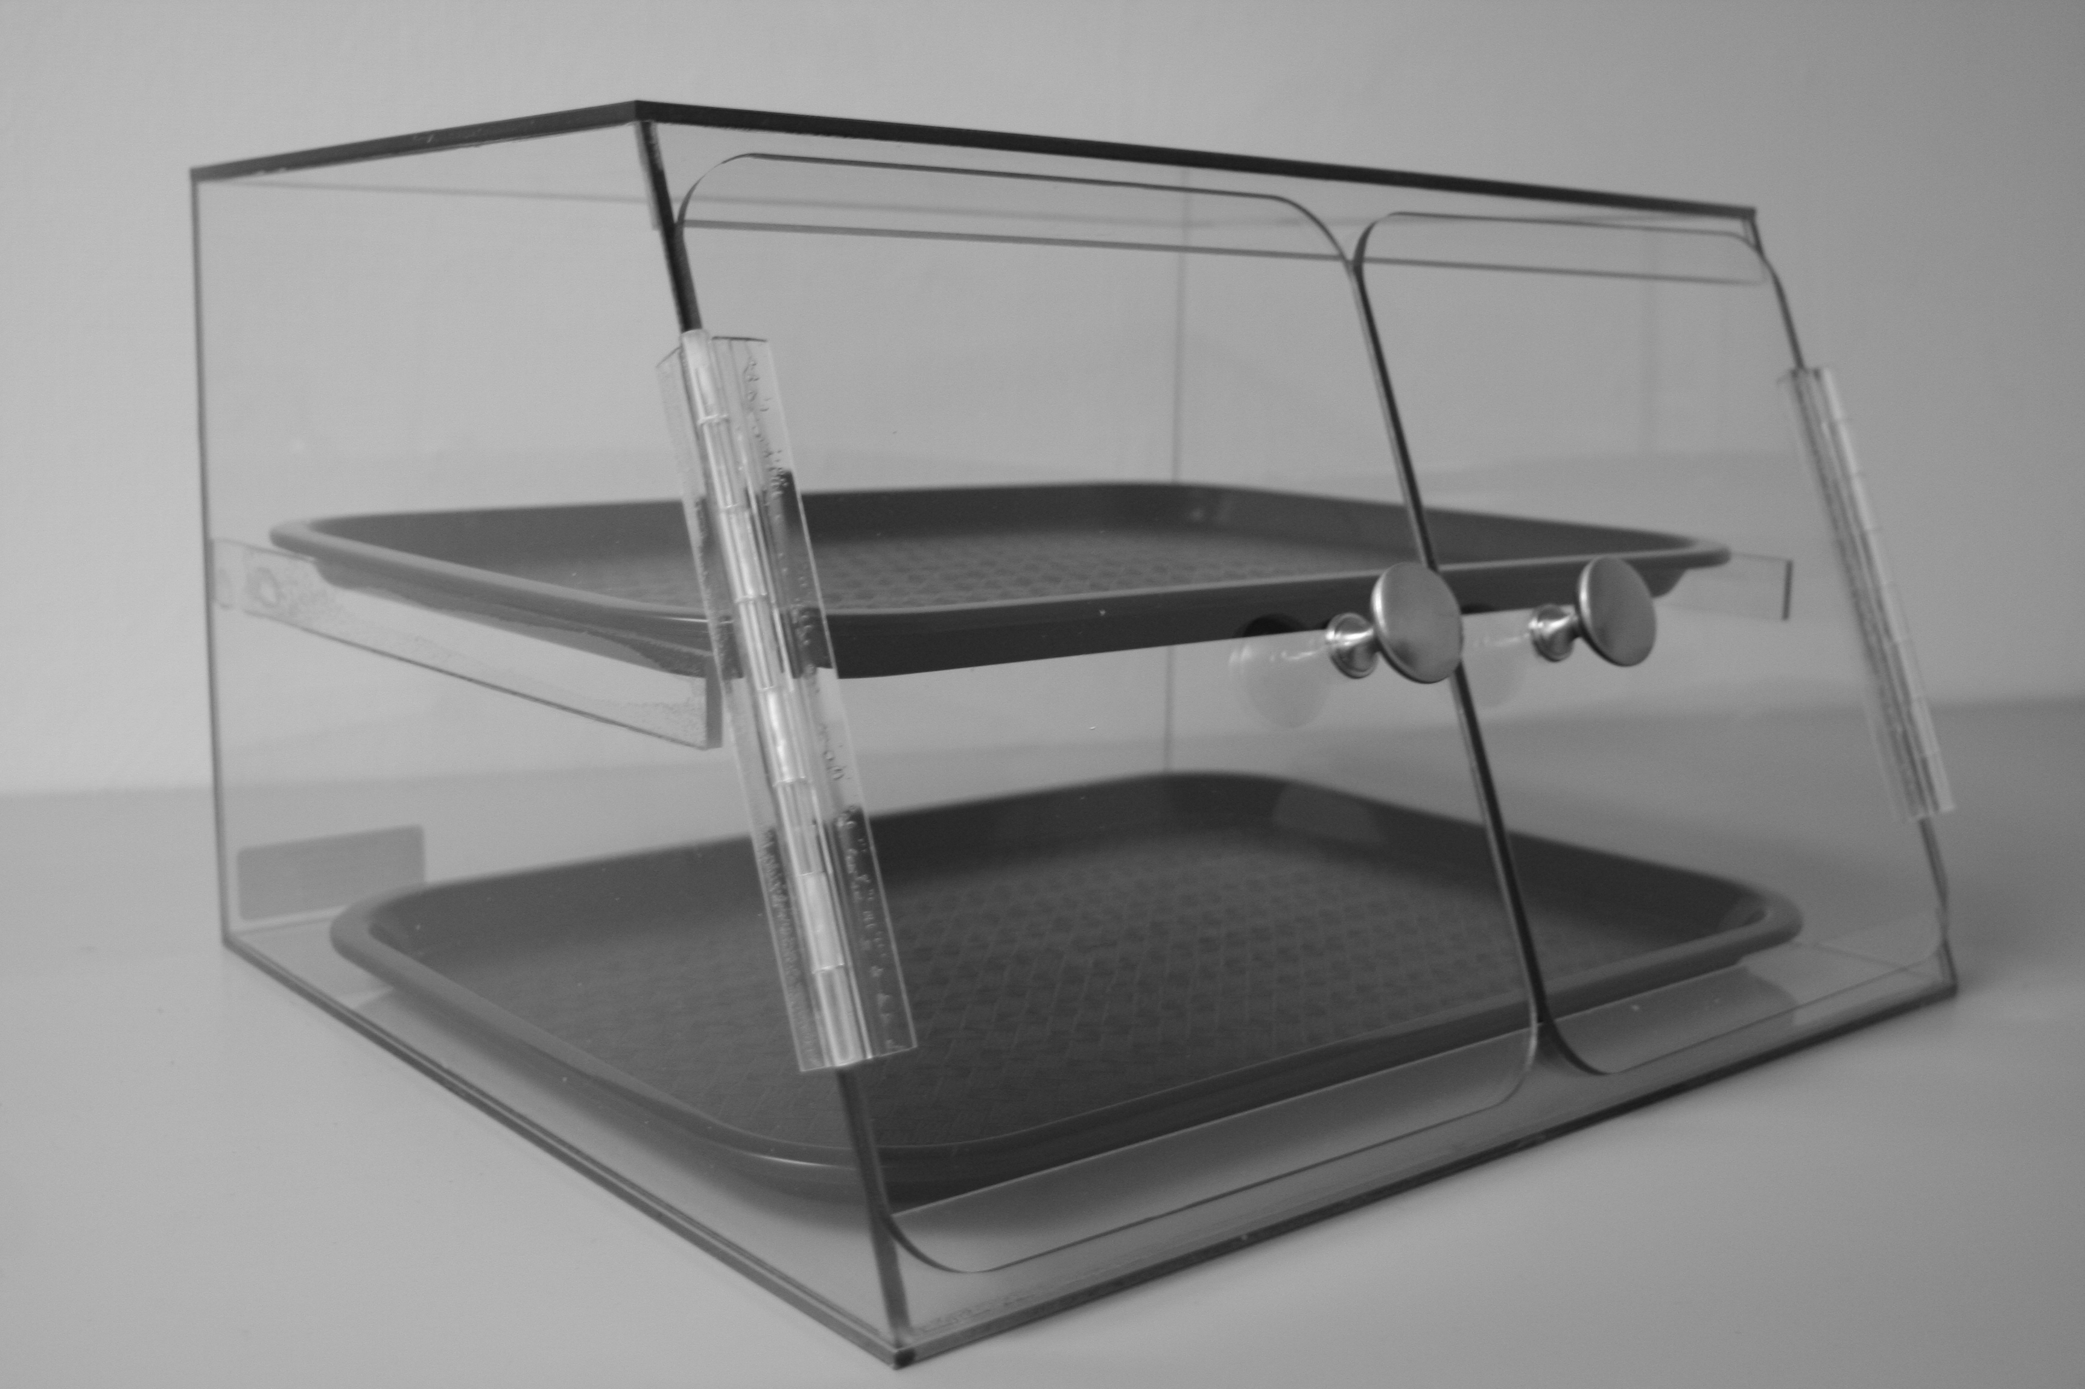
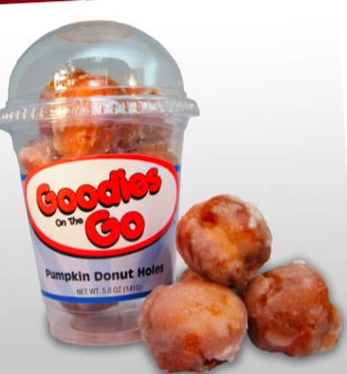
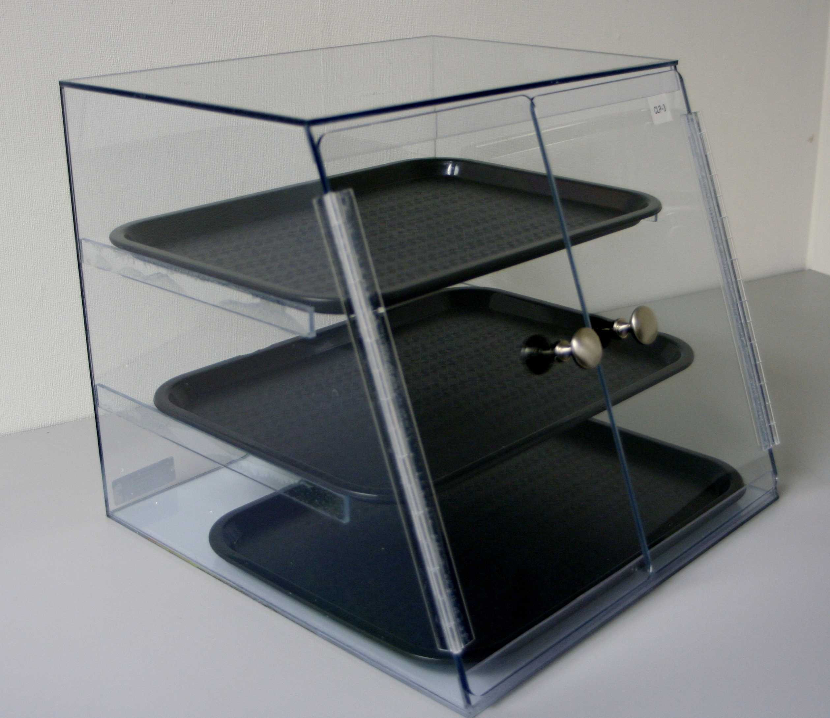
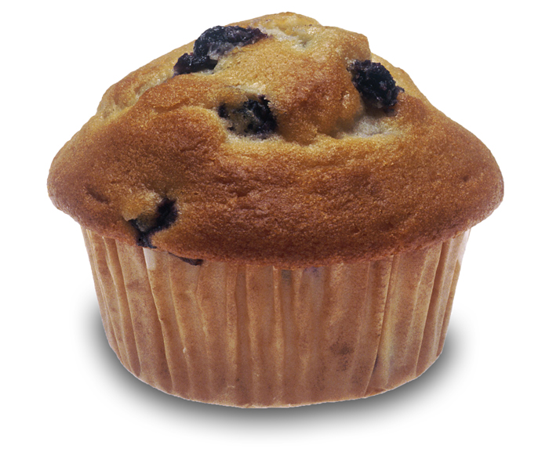
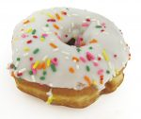
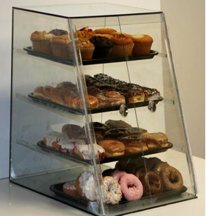
BAKERY RACK ORDER FORM
Donut Cup Holder
#DHR Cost $60
2 Free Cases of Donut Holes
$2.59 SRP
$62 in retail sales
FREE GOODS
Donuts 6 per Tray Donuts Bulk or IW | Ct
Auntie Em's Glazed Yeast Ring Donut 24 Ct. | 24
Auntie Em's Glazed Bowtie Donut 32 Ct. | 32
Auntie Em's Sour Crème | 24
Auntie Em's Choc John w/sprinkles Custard | 24
Auntie Em's Raspberry Bismark | 24
Auntie Em's Choc Long John (crème) | 24
Auntie Em's Variety - 48 Count | 48
2 Tier Bakery Display
#BD2T Cost $150
3 Free Cases of Auntie Ems
Avg $1.39 SRP
$!00 in retail sales
FREE GOODS
Donut Holes | Ct
Auntie Em's Donut Hole Plain | 12
Auntie Em's Donut Hole Glazed | 12
Auntie Em's Donut Hole Cherry | 12
Auntie Em's Donut Hole Chocolate | 12
3 Tier Bakery Display
#BD3T Cost $300
6 Free Cases of Auntie Ems
Avg $1.39 SRP
$200 in retail sales
FREE GOODS
Muffins | Ct
Aunte Em's Muffin Variety 36 Count | 36
12 each - Chocolate Chip, Blueberry, Banana Nut
Bulk 6 per Tray Variety Pack Cases | CT
Auntie Em's Donut Variety 24 Count | 24
Auntie Em's Cake Donut Assortment | 48
Auntie Em's Yeast Donut Assortment | 24
Auntie Em's Variety - 48 Count | 48
4 Tier Bakery Display
#BD4T Cost $350
7 Free Cases of Auntie Ems
Avg $1.39 SRP
$233 in retail sales
FREE GOODS
Account Name: Wholesaler:
Customer Number:
Sales Person Name:
Customer Contact Name:
Address:
Phone:
Signature: ________________________________
All pricing is delivered cost including freight. All sales final
Send order form to: tony@Berarducci.com
724.612.7034 ph, 412.291.2112 fax

